Slide 1
Marketing Campaign – Data Analytics
Data Quality: The raw data contained no null values or major outliers.
Preprocessing: Data was processed, cleaned, and segmented in a Google Colab notebook.
SQL Implementation: SQL queries for predefined functions were segmented within Colab.
Power BI Reporting: Three pages of visualizations were derived in Power BI:
Country-based Analysis
Age-based Analysis
Overall Analysis

Slide 2
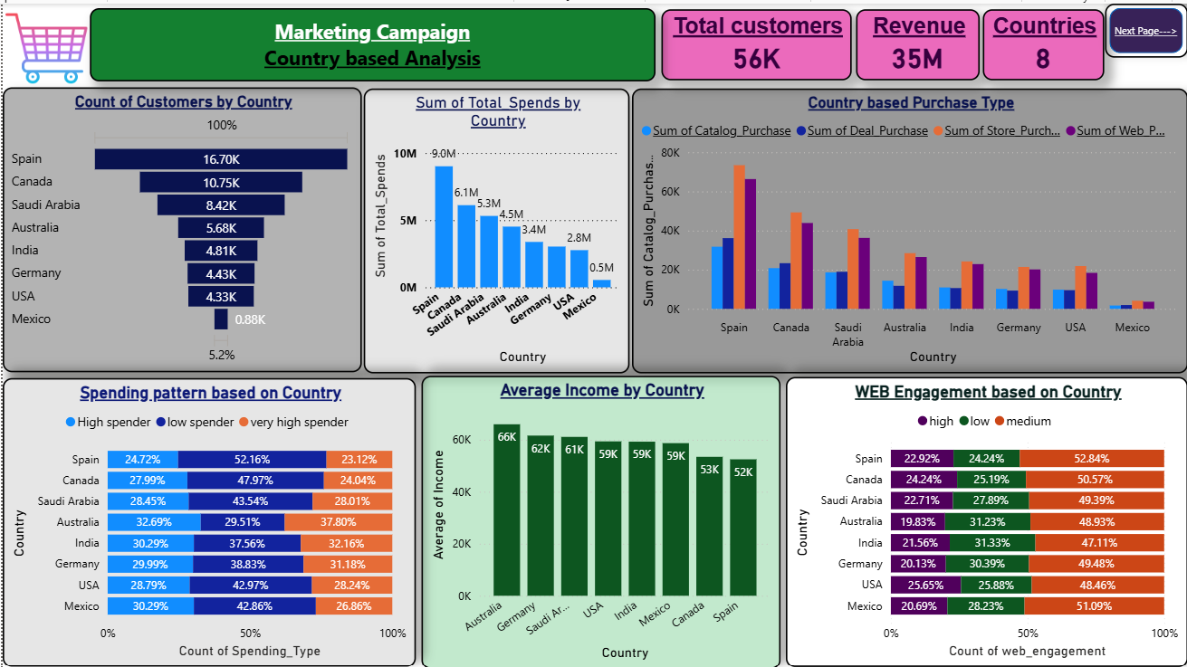

Slide 3
Country-based Performance Insights
Spain emerges as the primary market, leading in both total customer count (16.7K) and total spend ($9.0M), followed by Canada and Saudi Arabia.
Revenue & Reach: The campaign successfully engaged 56K total customers across 8 countries, generating a total revenue of $35M.
Store and Web purchases are the dominant channels across all regions.
Spain shows the highest volume across all purchase types (Catalog, Deal, Store, and Web).
The Low Spender category makes up the largest segment in most countries, particularly in Spain (52.16%) and Canada (47.97%).
Over 75% of the customer base maintains "Medium" to "High" web engagement, indicating strong digital campaign resonance.

Slide 4
Growth Opportunity – Country based
There is a clear correlation between higher average income (Australia, Germany) and the percentage of high-tier spenders, suggesting premium targeting opportunities in those regions.
Australia have a smaller customer base compared to Spain, they actually lead the pack in Average Income at $66,000. More importantly, if you look at the 'Spending Pattern' chart, Australia has the highest percentage of 'Very High Spenders' at nearly 38%. This suggests that while the volume is lower, the quality of the lead is much higher, offering a massive opportunity for premium product upselling.
Moving forward, we should look into find more customers in Australia, Germany and the USA who match that high-income, high-spending profile to further boost that $35 million revenue figure.

Slide 5
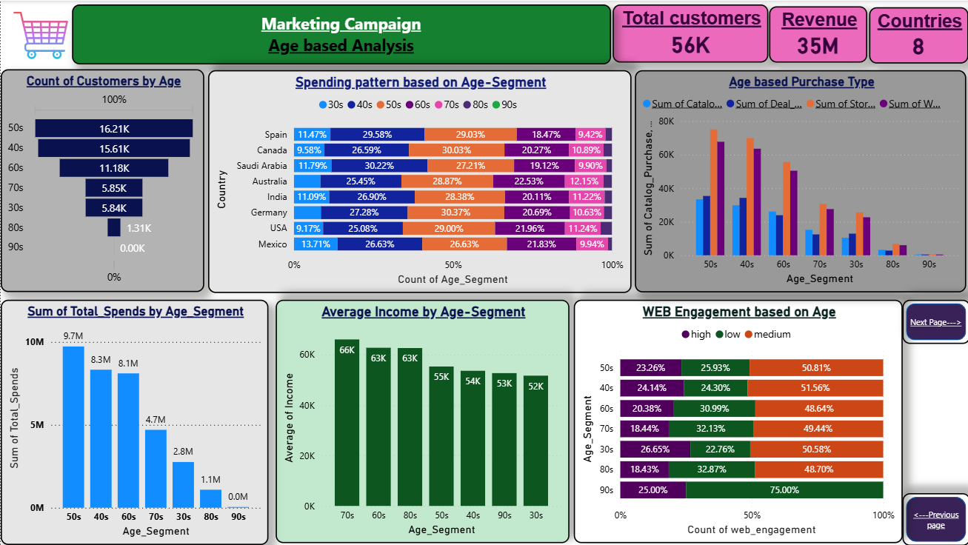

Slide 6
Age-based Performance insights
The 50s and 40s age groups are the campaign's largest contributors, representing 16.21K and 15.61K customers, respectively.
Total spending is heavily skewed toward older demographics, with the 50s segment leading at $9.7M, followed by the 40s ($8.3M) and 60s ($8.1M). These three groups account for the vast majority of the $35M total revenue.
The 70s segment has the highest Average Income at $66K, While the 50s spend the most in total, the older segments (60s-80s) maintain higher average individual incomes, suggesting a "quality over quantity" customer base in the senior brackets.

Slide 7
Growth Opportunity – Age based
Interestingly, the 30s and 40s segment shows the highest "High Engagement" rate at 26.65%, indicating that younger customers are more active online even if their total spend is currently lower.
Providing more Stable UI, offering deals on products in online and suggesting relevant products might increase the revenue figure among 30s and 40s.
While the 30s segment currently has the lowest spend of our active groups at $2.8M, they are our most digitally active. As this group moves into their peak earning years (the 40s and 50s), we have a prime opportunity to grow with them by maintaining that high digital touchpoint.

Slide 8
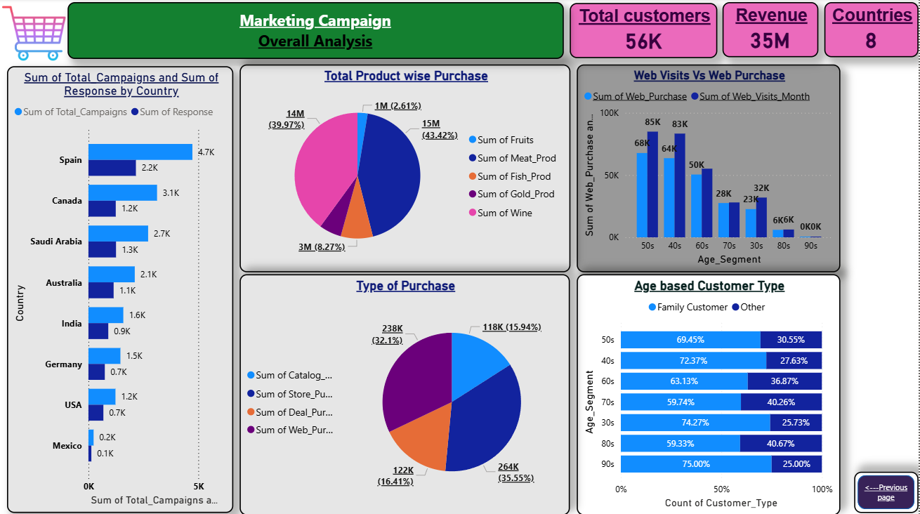

Slide 9
Overall Performance & Strategic Insights
Meat (43.42%) and Wine (39.97%) are the primary revenue drivers, accounting for over 83% of total sales. Fruits, Fish, and Gold represent room for growth.
Campaign Efficiency: Spain leads in both campaign volume (4.7K) and engagement (2.2K), maintaining an impressive response rate of nearly 47%. Canada and Saudi Arabia follow as high-responding secondary markets.
In-store purchases (35.55%) and Web purchases (32.1%) are the dominant channels.
The 50s and 40s segments show the highest digital intent, with 68K and 64K monthly web visits, respectively. The conversion from "Web Visits" to "Web Purchase" is exceptionally efficient in these age brackets.
Family Customers make up the majority of the base across all age groups, peaking in the 90s (75%), 30s (74.27%), and 40s (72.37%) segments. This indicates that marketing should continue to lean into family-oriented value propositions.

Slide 10
Growth Opportunities
Organizing more campaigns in countries like Australia, India, Germany, and the USA can boost customer numbers, as the response rates in these regions are high.
Designing a simpler, more user-friendly website UI will likely attract larger customer groups. Since store purchases currently lead, offering web discounts can boost online revenue and reduce reliance on physical store spending.
Data confirms a strong family-centric brand identity, with over 60% of customers across all age demographics (30s–90s) identifying as "Family Customers.“
Prioritizing family-oriented products and tailored discounts will help attract and retain more family-based customers.

